Slide 1
Georgetown Divide Public Utility District Annexation of Irrigation Parcels
LAFCO Project No. 2025-03
Agenda Item #1
September 23, 2026

Slide 2
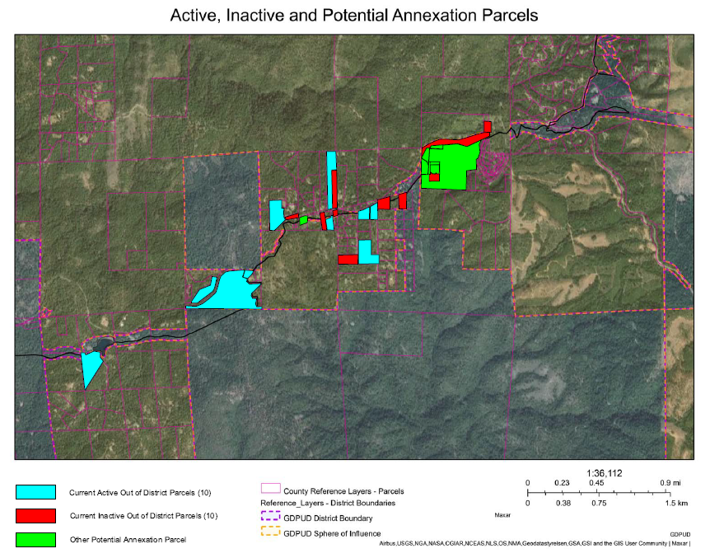
Georgetown Divide PUD Annexation of Irrigation Parcels
LAFCO Project No. 2025-03
Proposal
Annex 27 parcels (242 acres) into GDPUD for raw water service
GDPUD does not provide treated water in the area
Location
Upcountry Georgetown Area, along approximately five miles of GDPUD ditch generally following Wentworth Springs Rd from Balderston Rd to Homewood Dr
Annexation of Existing Customers
Parcels currently receive raw water at outside-District rates, previously received raw water, or can and want to connect to GDPUD’s ditch system.
Outside-District Customer Status
Active: 10
Inactive/Prior: 10
Other (interested, administrative): 7
GDPUD Sphere of Influence
Wentworth Springs Rd
Homewood Dr
Wentworth Springs Rd
Balderston Rd
GDPUD Service Area

Slide 3
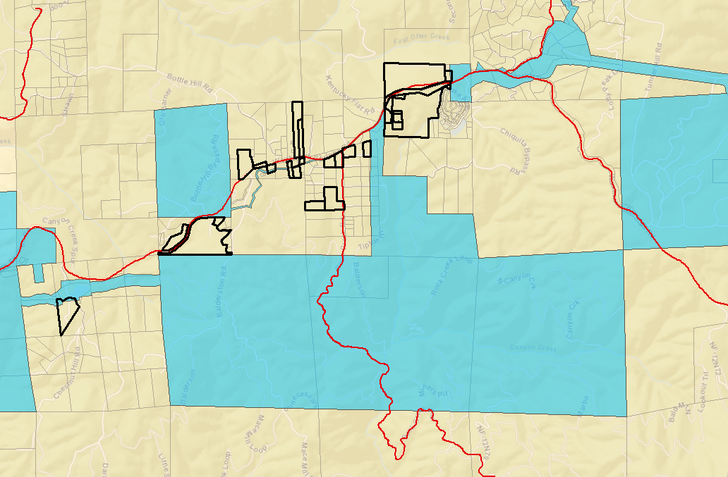
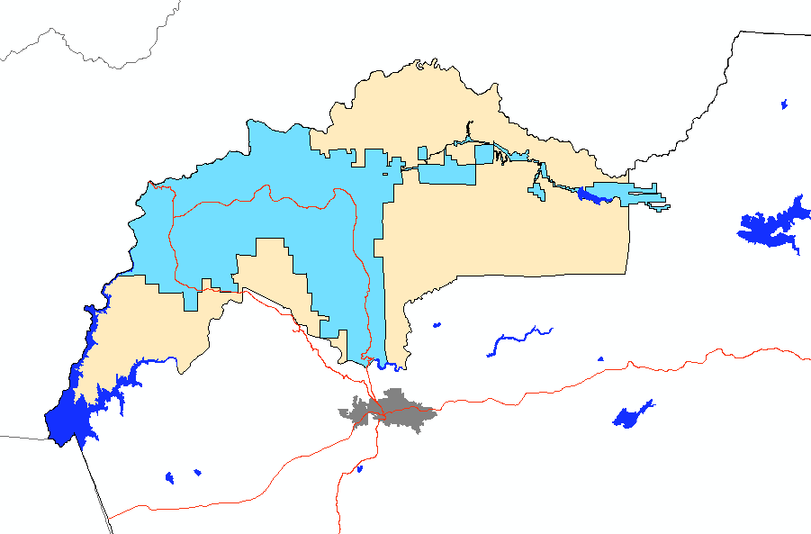
Georgetown Divide PUD Annexation of Irrigation Parcels
LAFCO Project No. 2025-03
Boundaries
Within GDPUD’s Sphere of Influence
Irregular boundary reflects current and historical raw water service
Effects of Annexation
Annexed parcels subject to inside-District raw water rates and eligible to participate in District elections
GDPUD will receive 7.6513% of future property tax increment within the annexation area
CEQA
GDPUD is the lead agency
Class 19 Categorical Exemption §15319: Annexation of existing public or private structures developed in accordance with current zoning
GDPUD Sphere of Influence
Volcanoville Rd
Breedlove Rd
Homewood Dr.
Wentworth Springs Rd
Wentworth Springs Rd
Rock Cree Rd
Balderston Rd
GDPUD Service Area

Slide 4
Georgetown Divide PUD Annexation of Irrigation Parcels
LAFCO Project No. 2025-03
Mailed Notices:
 | Affected Territory | 500ft Buffer
Landowners | 23 | 105
Registered Voters | 39 | 112
Conducting Authority (Protest) Hearing:
  Provides landowners and registered voters within the affected territory an opportunity to formally protest the annexation.
  Required because the annexation was initiated by GDPUD Board resolution without written consent from all affected landowners.
  Protest proceedings cannot be waived because written opposition has been received from an affected landowner.
  Staff recommends scheduling the protest hearing for December 2, 2026.
  Any landowner or registered voter within the affected territory may submit a written protest.
  Notice and protest forms will be mailed 21-days before the hearing.

Slide 5
Georgetown Divide PUD Annexation of Irrigation Parcels
LAFCO Project No. 2025-03
Staff Recommends that the Commission:
  Open the public hearing;
  Consider the information in the Executive Officer’s report and receive and discuss the presentation from staff relating to the proposal;
  Receive public comments;
  Close the public hearing;
  Find that the project is exempt from CEQA under Categorical Exemption 15319 and direct staff to file a Notice of Exemption;
  Adopt Resolution L-2026-09, adding any additional conditions the Commission finds appropriate, and approve the GDPUD Annexation of Irrigation Parcels; LAFCO Project No. 2025-03
  Set the Conducting Authority proceedings for this proposal on December 2, 2026, and direct the Executive Officer to open the protest period and notify the appropriate parties, pursuant to Government Code §57000 and local policies;
  Direct the Executive Officer to complete the necessary filings and transmittals as required by law; and
  Determine the effective date of the approval of this Annexation to be five (5) working days after the Certificate of Completion is recorded once the imposed conditions are met.

