Slide 2
Reorganization of the Diamond Springs-El Dorado and El Dorado County Fire Protection Districts LAFCO Project No. 2025-01
Agenda Item #1
January 28, 2026

Slide 3
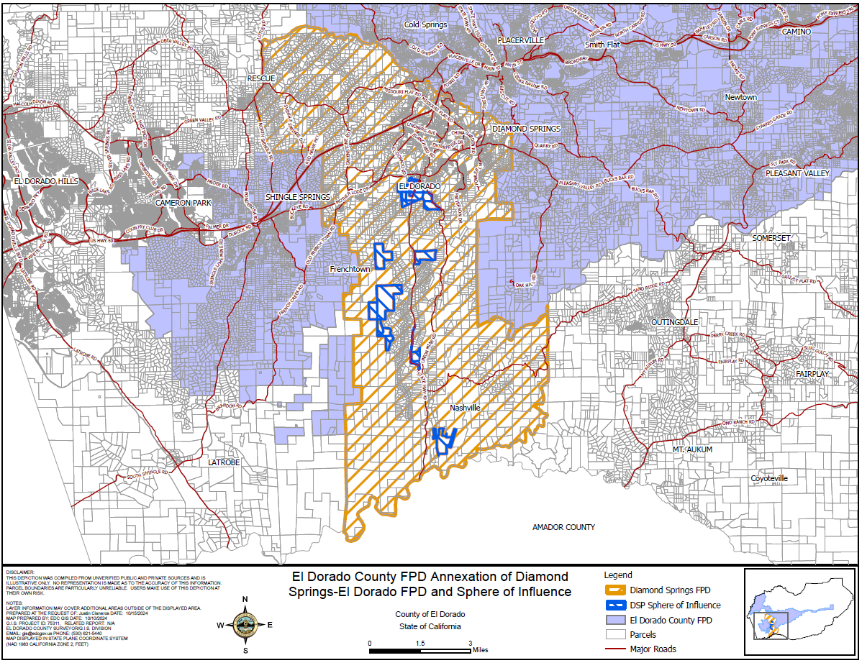
Reorganization of the Diamond Springs-El Dorado Fire Protection District
and the El Dorado County Fire Protection District
Proposal
Reorganization of the DSFPD and EDCFPD:
Annexation of the DSFPD service area and sphere of influence into the EDCFPD (Shingle Springs Zone)
Concurrent dissolution of the DSFPD
Purpose
Consolidate personnel, operations, facilities, budgets, and governance under EDCFPD.
The reorganization is expected to maintain current service levels, increase efficiency, meet local service expectations, and preserve existing funding mechanisms.

Slide 4
Reorganization of the Diamond Springs-El Dorado Fire Protection District
and the El Dorado County Fire Protection District
Milestones and Key Steps Leading up to Reorganization
April 2022 | LAFCO adopts Countywide Fire Protection and Emergency Medical Services MSR-SOI Update
October 2022 | Shared Service Agreement between DSFPD & EDCFPD
January 2023 | LAFCO presentation to both District Boards, outlining the processes involved with an Annexation and Consolidation
February 2023 | First, monthly, DSFPD EDCFPD Working Group meeting held
February 2023 | DSFPD & EDCFPD Board of Directors approve Resolutions of Intent for Annexation and Dissolution
April 2023 | DSFPD & EDCFPD Board of Directors enter into an agreement with Fitch & Associates to complete Annexation Feasibility Study
April 2024 | DSFPD & EDCFPD Boards adopt the Annexation Feasibility Study
July 2024 | DSFPD & EDCFPD Board of Directors authorize an agreement an Annexation Consultant
September 2024 | Senate Bill 1240 signed by Governor, effective immediately
November 2024 | DSFPD & EDCFPD Board of Directors adopt Resolutions to Initiate Proceedings for Annexation and Dissolution
December 2024 | Initial Application materials submitted to LAFCO
May 2025 | First Addendum to the Resolutions of Application to clarify intent to annex subject territory into EDCFPD Shingle Springs Zone
May 2025 | LAFCO Application Completed
November 2025 | Property Tax negotiations completed by the BOS and Districts
January 28, 2026 | LAFCO Public Hearing date
March 25, 2026 | Conducing Authority Hearing and end to Protest Period
Date tbd | Certificate of Completion recorded; Effective date of Reorganization is 5 business days after

Slide 5
Reorganization of the Diamond Springs-El Dorado Fire Protection District
and the El Dorado County Fire Protection District
Annexation Feasibility Study
Adopted by the DSFPD and EDCFPD Boards in April 2024
Six key findings in support of the reorganization:
The communities would benefit from the annexation of the two districts.
No staffing reductions or station closures are proposed.
The addition of a Battalion Chief would enhance operational capacity, training, safety, and risk reduction for both the community and firefighters.
No new facilities are needed, as services will continue to be delivered from existing stations.
Sufficient revenues are available to support a joint annexation.
The combined unfunded accrued liability (UAL) and other post-employment benefit (OPEB) obligations should be carefully considered, and adequate reserves should be maintained for the new entity.

Slide 6
Reorganization of the Diamond Springs-El Dorado Fire Protection District
and the El Dorado County Fire Protection District
AB 8 Property Tax Redistribution Resolutions
Adopted by the El Dorado County Board of Supervisors November 4, 2025
BOS Resolution 164-2025 approves the exchange of property tax base and increment for all parcels within the reorganization territory:
DSFPD service area – the entire property tax base and existing increment from DSFPD will be transferred to EDCFPD (20.6% average)
DSFPD SOI – negotiations for a future property tax increment to EDCFPD of 21.8% to 23.1%
BOS Resolution 165-2025 authorizes a one-time payment of $400,000 to EDCFPD to cover the costs associated with administrative expenses

Slide 7
Reorganization of the Diamond Springs-El Dorado Fire Protection District
and the El Dorado County Fire Protection District
 | Current | Proposed Change
Governance | Two Boards of Directors DSFPD – 5 Member Board EDCFPD – 5 Member Board | One Board of Directors EDCFPD – 7 Member Board (5 EDCFPD directors, 2 DSFPD directors), elected by division thereafter.
Level of Service | DSFPD – Station No. 49 is staffed 24/7 with a three-person engine crew EDCFPD – minimum daily staffing level of three personnel per engine (Engine 72 in Cool operates with two personnel) | No Change to the Level of Service The districts have committed that the same or an improved level of service be provided to the communities.
Fire Stations & Equipment | DSFPD (6): one staffed fire station, five unstaffed EDCFPD (12): five staffed fire stations, seven unstaffed | No Change to Existing Fire Stations or Equipment All DSFPD apparatus, facilities, and buildings will be transferred to EDCFPD. No station closures are proposed.
Staffing | Two Fire Chiefs & Separate Personnel Departments DSFPD – Fire Chief, 11 uniformed personnel, 2 support staff EDCFPD: Fire Chief, 80 uniformed personnel (30 positions JPA funded), 3 support staff | No Change in Firefighters or Administrative Staff All DSFPD personnel will become employees of EDCFPD. Both current Fire Chiefs will retire and be succeeded by a single EDCFPD Fire Chief and one Deputy/Assistant Chief.
Pension Benefits | Separate Pension Plans under CalPERS for each district | No Change to Existing Pension Plans Pursuant to SB 1240, active and retired DSFPD employees will retain their existing CalPERS pension benefits under EDCFPD. New hires will be enrolled in EDCFPD’s plan.
Finances | DSFPD (FY23-24): Budget = $4.8 Million Total Reserves = $4.5 Million Average PT increment = 20.57% Special Assessments = None EDCFPD (FY23-24): Budget = $16.4 Million Total Reserves = $8.5 Million Average PT increment = 13.82% Special Assessments = None in Shingle Springs Zone | Combined Finances EDCFPD will operate under a single district-wide budget going forward. All existing DSFPD revenues, expenditures, assets, and liabilities will be transferred to EDCFPD as the successor agency. DSFPD residents will experience no change in property tax or special tax rates as a result of the reorganization.

Slide 8
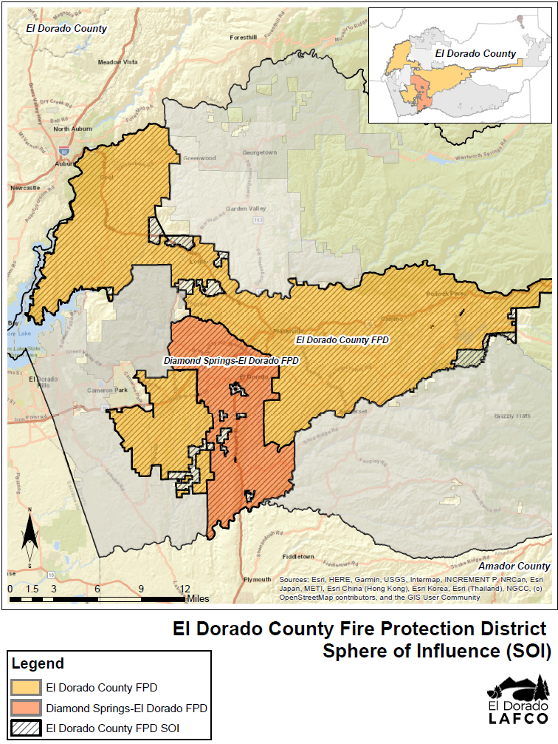
Reorganization of the Diamond Springs-El Dorado Fire Protection District
and the El Dorado County Fire Protection District
Sphere of Influence (SOI) Consistency
All Commission determinations regarding annexations and dissolutions must be consistent with the spheres of influence of the affected agencies.
Reorganization proposal 2025-01 is subject to the Commission’s approval of the SOI updates in L-2026-01:
Zero sphere of influence for DSFPD
Expansion of EDCFPD’s sphere to encompass DSFPD’s current service area and SOI
Agenda Item #6

Slide 9
Reorganization of the Diamond Springs-El Dorado Fire Protection District
and the El Dorado County Fire Protection District
Reconsideration Period (30 days):
Requests for reconsideration shall state the specific modification to the resolution(s) being requested and shall state what new or different facts that could not have been presented previously are claimed to warrant the reconsideration
Conducting Authority Hearing (protest period 55 days):
Required because the reorganization was initiated by the Districts
Provides an opportunity for landowners and registered voters within the affected territory to protest the reorganization
Staff recommends scheduling the conducting authority hearing for March 25, 2026
Any landowner or registered voter within the affected territory (DSFPD service area and SOI) may submit a written protest
Protest form available on the LAFCO website January 29, 2026
Protest thresholds:
Less that 25% protest – order the reorganization without election
25-50% protest – order the reorganization subject to an election
50% or more protest – terminate the reorganization

Slide 10
Reorganization of the Diamond Springs-El Dorado Fire Protection District
and the El Dorado County Fire Protection District
Staff Recommends that the Commission:
Open the public hearing
Consider all information relating to the sphere of influence updates for the Diamond Springs-El Dorado Fire Protection District and the El Dorado County Fire Protection District and the reorganization of the Diamond Springs-El Dorado and El Dorado County Fire Protection Districts
Receive public comments
Close the public hearing
Find that the project is categorically exempt from CEQA under CEQA Guidelines Sections 15320 and 15061(b)(3); and direct staff to file a Notice of Exemption
Adopt Resolution L-2026-01, adopting sphere of influence updates for the Diamond Springs-El Dorado and El Dorado County Fire Protection Districts
Adopt Resolution L-2026-02, adding any additional conditions the Commission finds appropriate, and approve the Reorganization of the Diamond Springs-El Dorado and El Dorado County Fire Protection Districts
Set the Conducting Authority proceedings for March 25, 2026, and direct the Executive Officer to open the protest period and notify the appropriate parties, pursuant to Government Code §57000 and local policies
Direct the Executive Officer to complete the necessary filings and transmittals as required by law
Determine the effective date of the approval of this Reorganization to be five (5) working days after the Certificate of Completion is recorded

