Slide 1
Targeted Fire MSR Updates
El Dorado LAFCo
January 28, 2026

Slide 2


Changes from Prior Draft MSR
Updated financial sections
Corrected budget tables
Updated audit/actuals tables
New summary of net position tables
Incorporated agency comments
Included maps of agencies
Updated staffing information
Minor edits and corrections for clarity

Slide 3
Notes on Agency Financials
Budgets may change throughout the year based on agency needs
Audited financial statements can be prepared in different formats depending on the level of detail and the entity preparing the audit
Audits generally include different types of financial tables including:
Statement of Changes in Fund Balances
Governmental Funds Balance Sheet
Statement of Fund Revenues, Expenditures, and Changes in Fund Balances

Slide 4
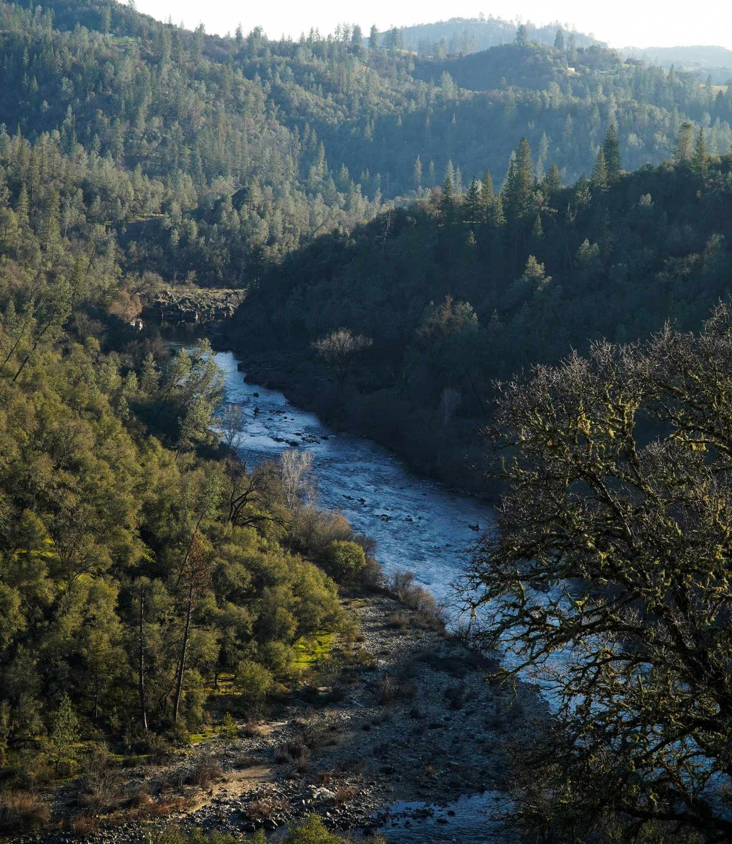





Agencies Reviewed

Slide 5
Fallen Leaf Lake FPD

Slide 6
Agency Overview
Formation: 1982
Boundary Area: 3,377 acres
Population:
5-33 residents year-round
Up to 1,500 visitors during busy weekends
Staffing: 14 paid, 8-10 paid on-call, 4 volunteers
Services:
Fire protection
Emergency medical response
Hazardous materials response
Defensible space inspections
Parks and recreation

Slide 7
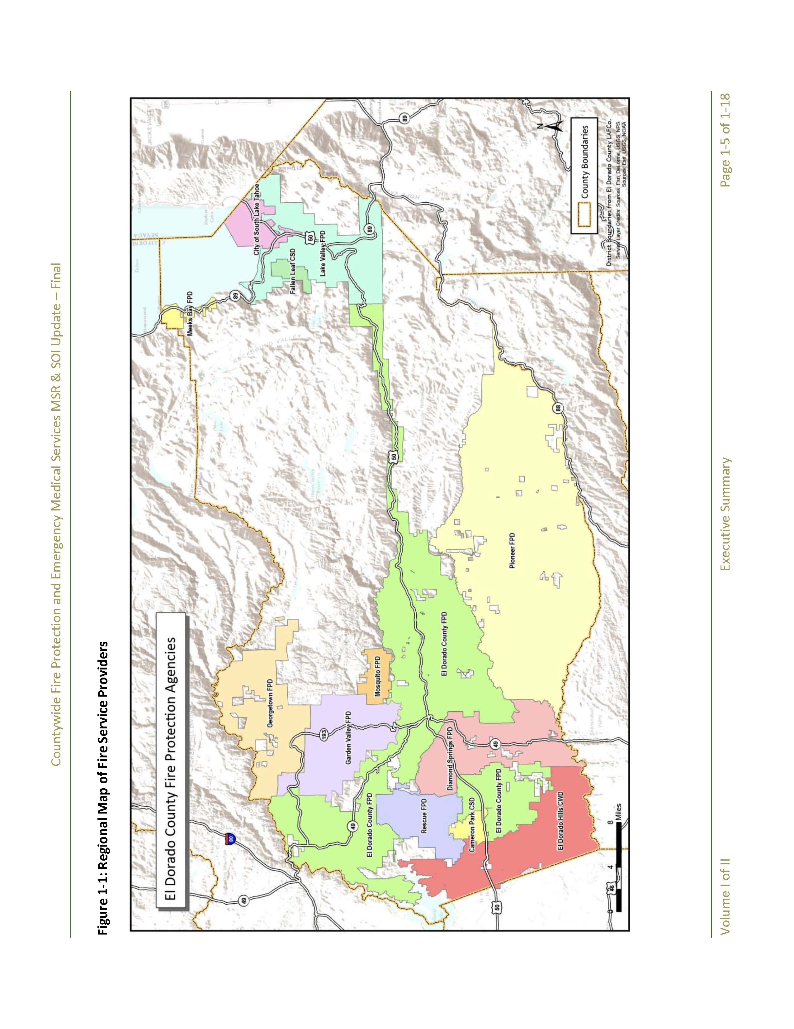

Slide 8
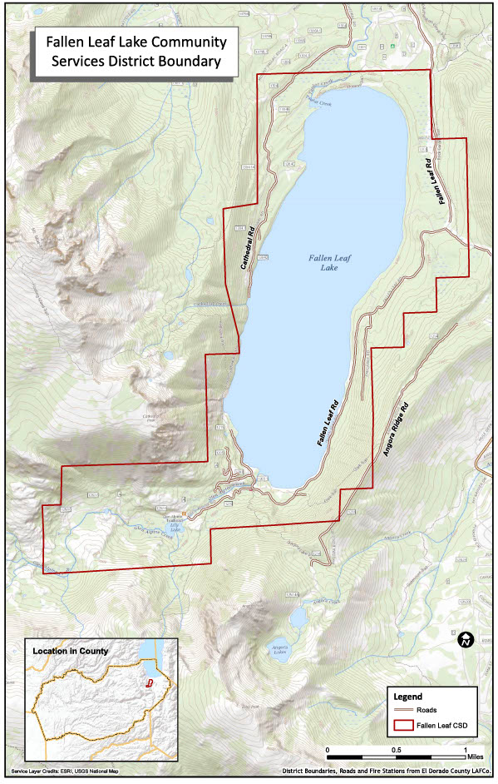

Slide 9
Fire Department
Operates from one station at the southern end of Fallen Leaf Lake
Station primarily serves east side of lake
Engine stationed on west of lake; accessed by boat or seasonal roads
Responds to approximately 57 calls annually
30-40% of calls are for medical emergencies
Average response time of 3-4 minutes for areas close to the station
Current ISO rating of 2/2Y (up from prior 4/9)
Provides vital emergency response to Glen Alpine Trailhead and nearby backcountry areas

Slide 10
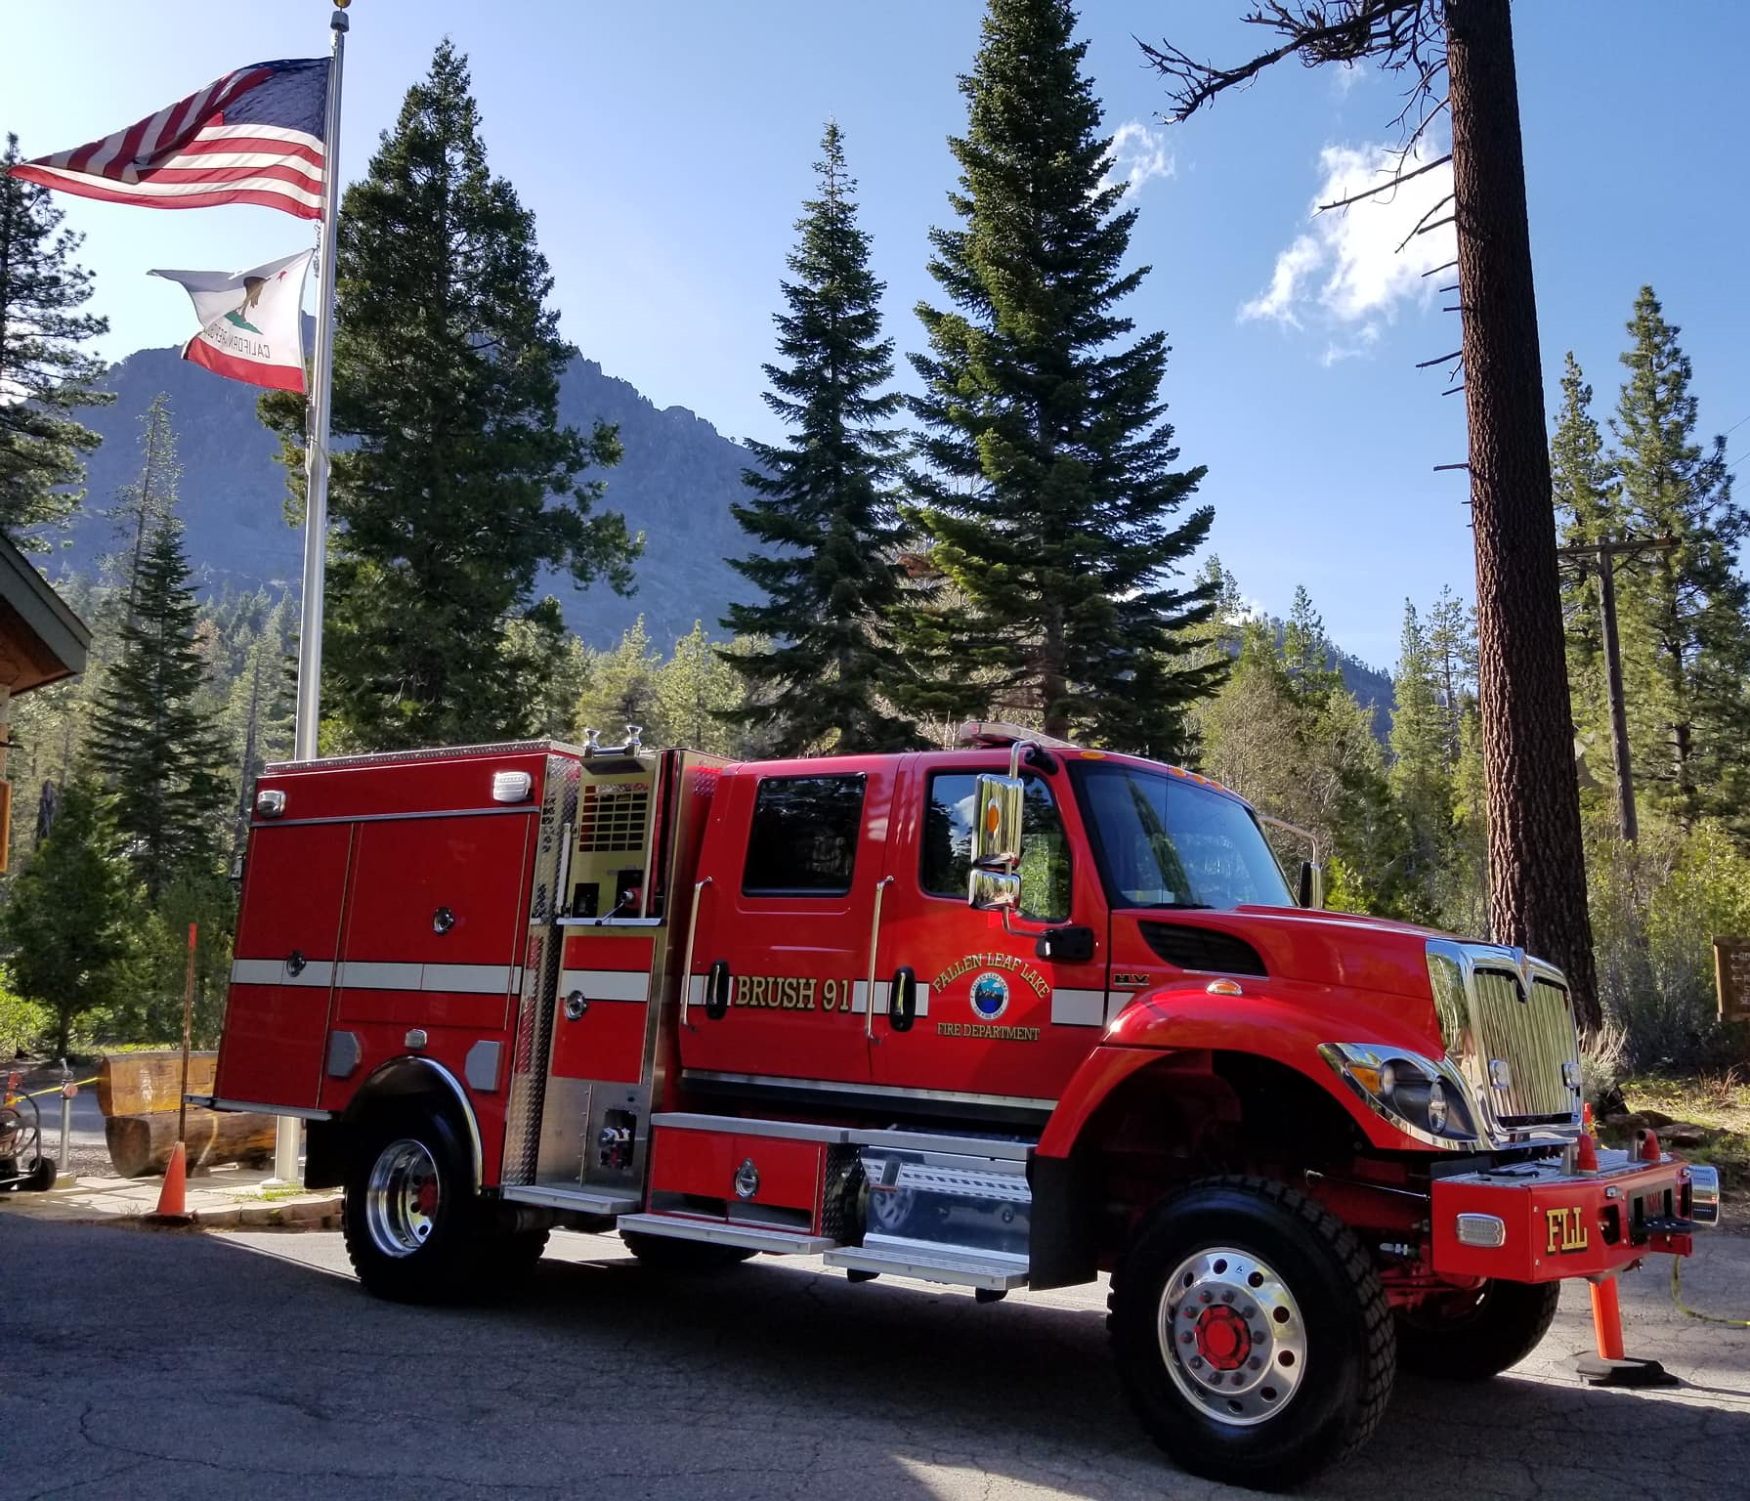
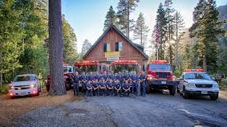
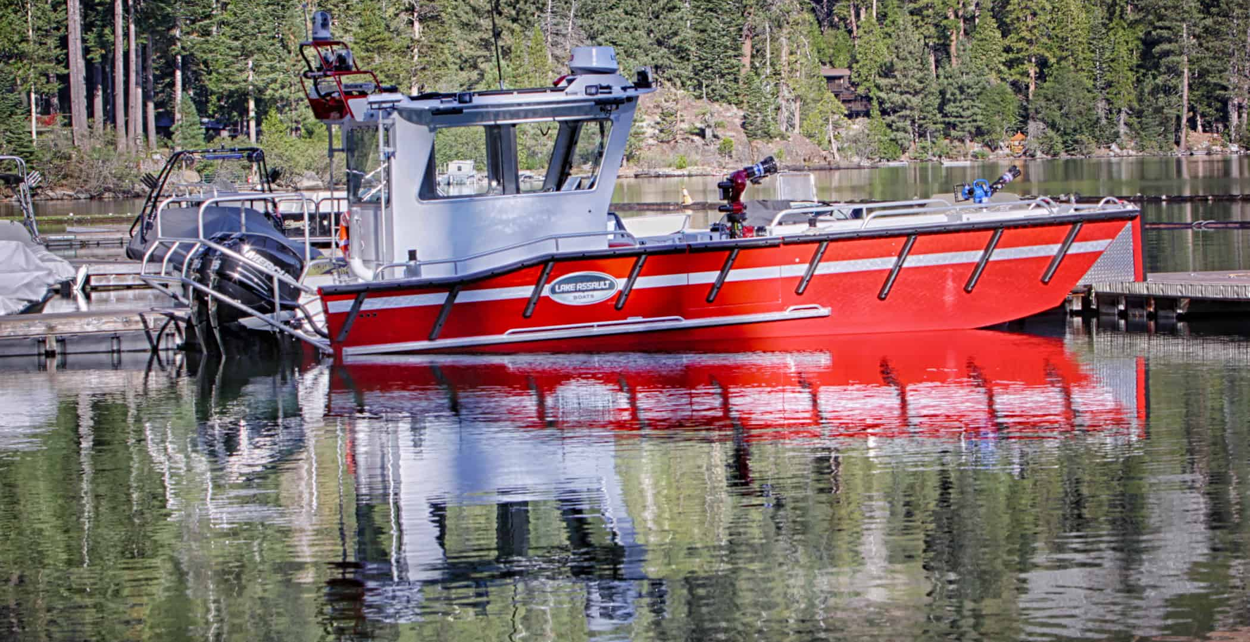
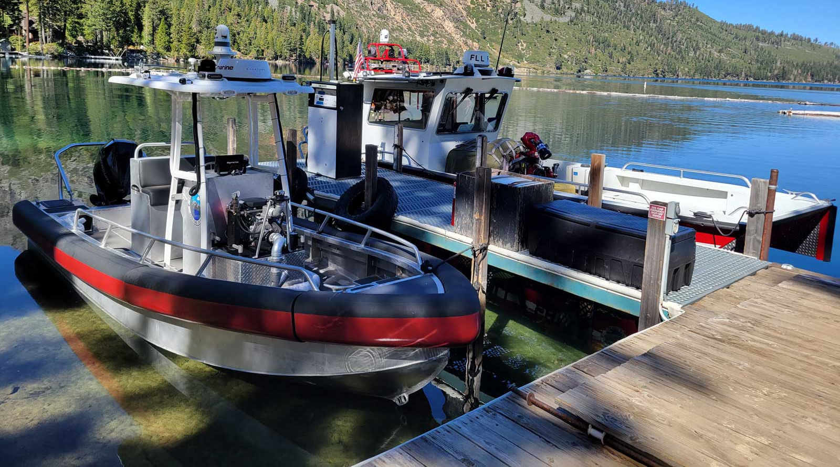

Slide 11
Financial Summary
FLLCSD Fire Department Reported Actuals
 | FY 2020-21 | FY 2021-22 | FY 2022-23
Revenues | $1,947,718 | $2,457,115 | $1,879,520
Expenses | $1,563,397 | $2,184,693 | $2,208,730
Gain/ (Loss) | $384,321 | $272,422 | $ (329,210)
Based on the last three years reviewed, the FLLCSD Fire Department has seen an overall net gain of $327,533
As of June 30, 2023, the Fire Department had $243,489 in long-term debt. FLLCSD reports that the fire boat has since been paid off, and three $36,841 payments remain for the BME Type 3 Model 34 fire engine ($110,523).
Notes:
Substantial capital outlay in FY2022-23 of $579,285.
Revenues:
Base property taxes
Direct assessment ($660 per parcel)
Strike team reimbursements
Grants
Donations
Expenditures
Salaries, wages, & payroll taxes (~57%)
Repairs, maintenance, supplies, small equipment, and utilities (~5%)
Insurance costs (~3%)

Slide 12
Garden Valley FPD

Slide 13
Agency Overview
Formation: November 1973
Boundary Area: 37,612 acres
Population: ~4,685 (3,586 registered voters)
Staffing: 4 staff & ~25 active volunteers
Services:
Fire protection (Structural and Wildland)
Emergency medical response (ALS & non-transport)
Hazardous materials response
Rescue & Extrication Operations
Fire Prevention & Safety Education

Slide 15
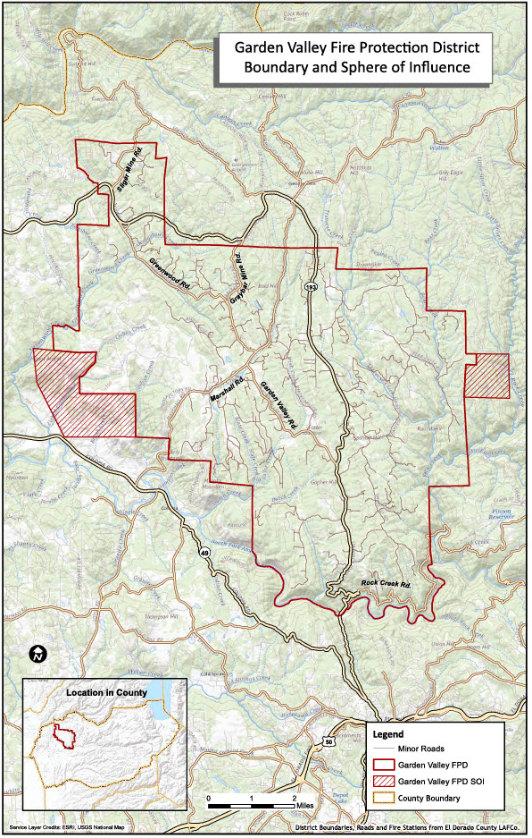

Slide 16
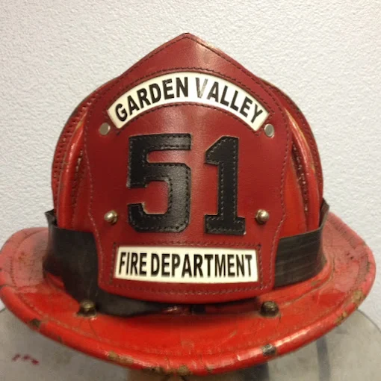
Fire Services
Operates from one main station in Garden Valley (#51)
Additional two unmanned stations in Greenwood (#53) and Kelsey (#52)
Responds to approximately 730 calls annually
~16% fire
~ 70% rescue & emergency medical
Average response time of ~ 22 min
Current ISO rating of 4/4X (up from prior 6/6X)

Slide 17
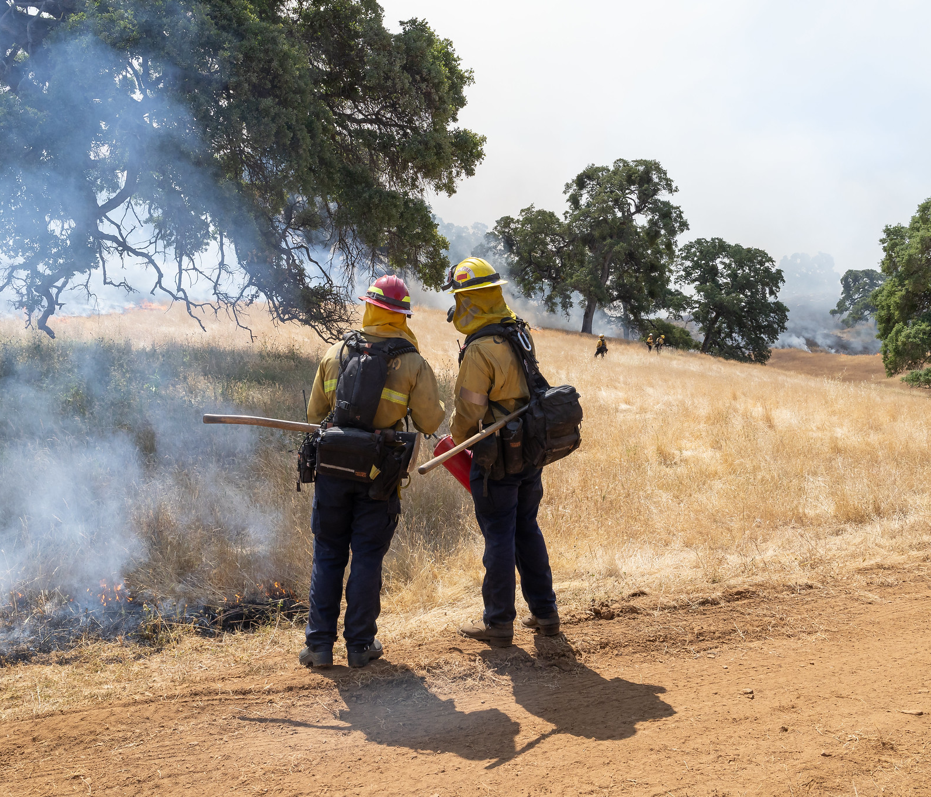

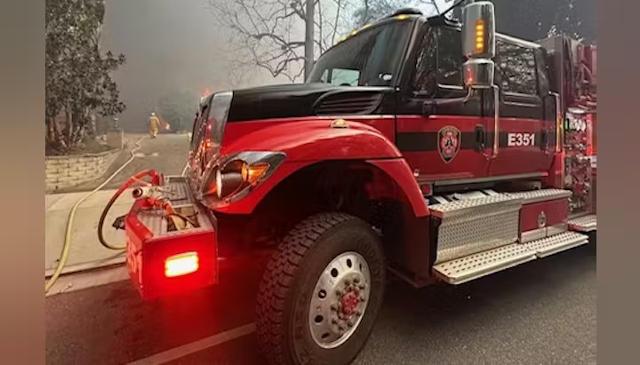
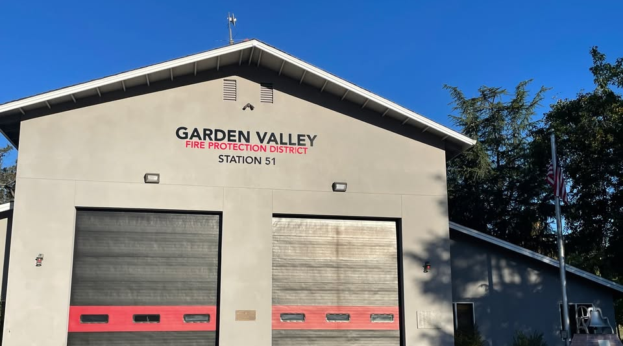

Slide 18
Financial Summary
GVFPD Audited Financial Statements
 | FY 2020-21 | FY 2021-22 | FY 2022-23
Revenues | $2,233,025 | $2,619,953 | $2,130,471
Expenses | $1,877,683 | $2,292,900 | $2,029,296
Gain/ (Loss) | $355,342 | $327,053 | $101,175
Based on the last three years reviewed, the GVFPD has seen an overall net gain of $783,570
As of June 30, 2023, the District had $992,915 in long-term liabilities including $872,151 in net pension liabilities.

Slide 19
Mosquito FPD

Slide 20
Agency Overview
Formation: December 1977
Boundary Area: 6,989 acres
Population: ~1,712 (953 registered voters)
Staffing: 4 staff, ~15 active volunteers
Services:
Fire protection (Structural and Wildland)
Emergency medical response
Rescue & Extrication Operations
Fire Prevention & Safety Education

Slide 22
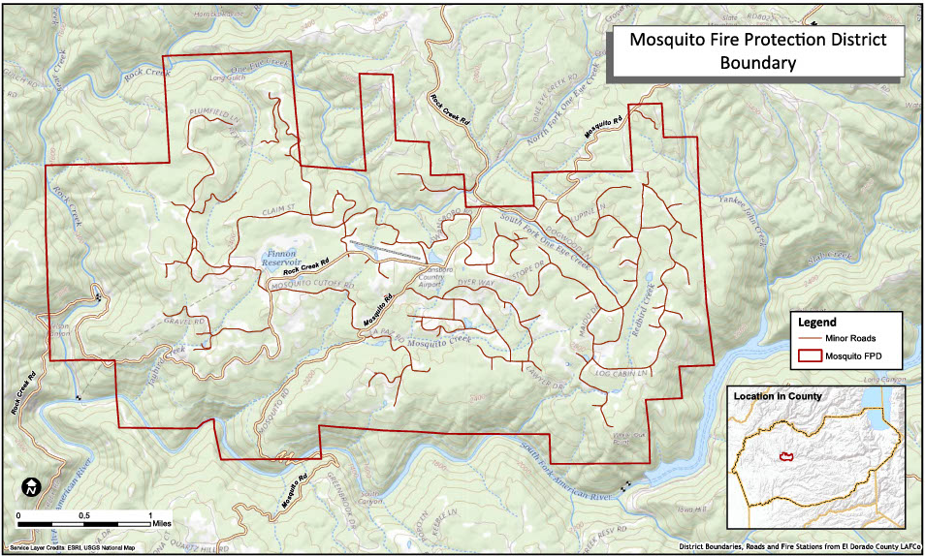

Slide 23
Fire Services
Operates from one main station in Mosquito (#75)
Responds to approximately 140 calls annually
~15% fire
~ 65% rescue & emergency medical
Average response time of ~ 28 min
Current ISO rating of 3/3Y (up from prior 5/8)

Slide 24
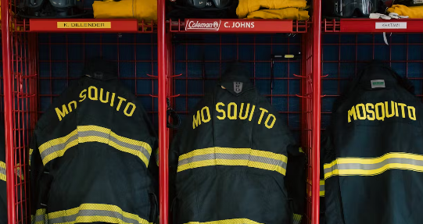
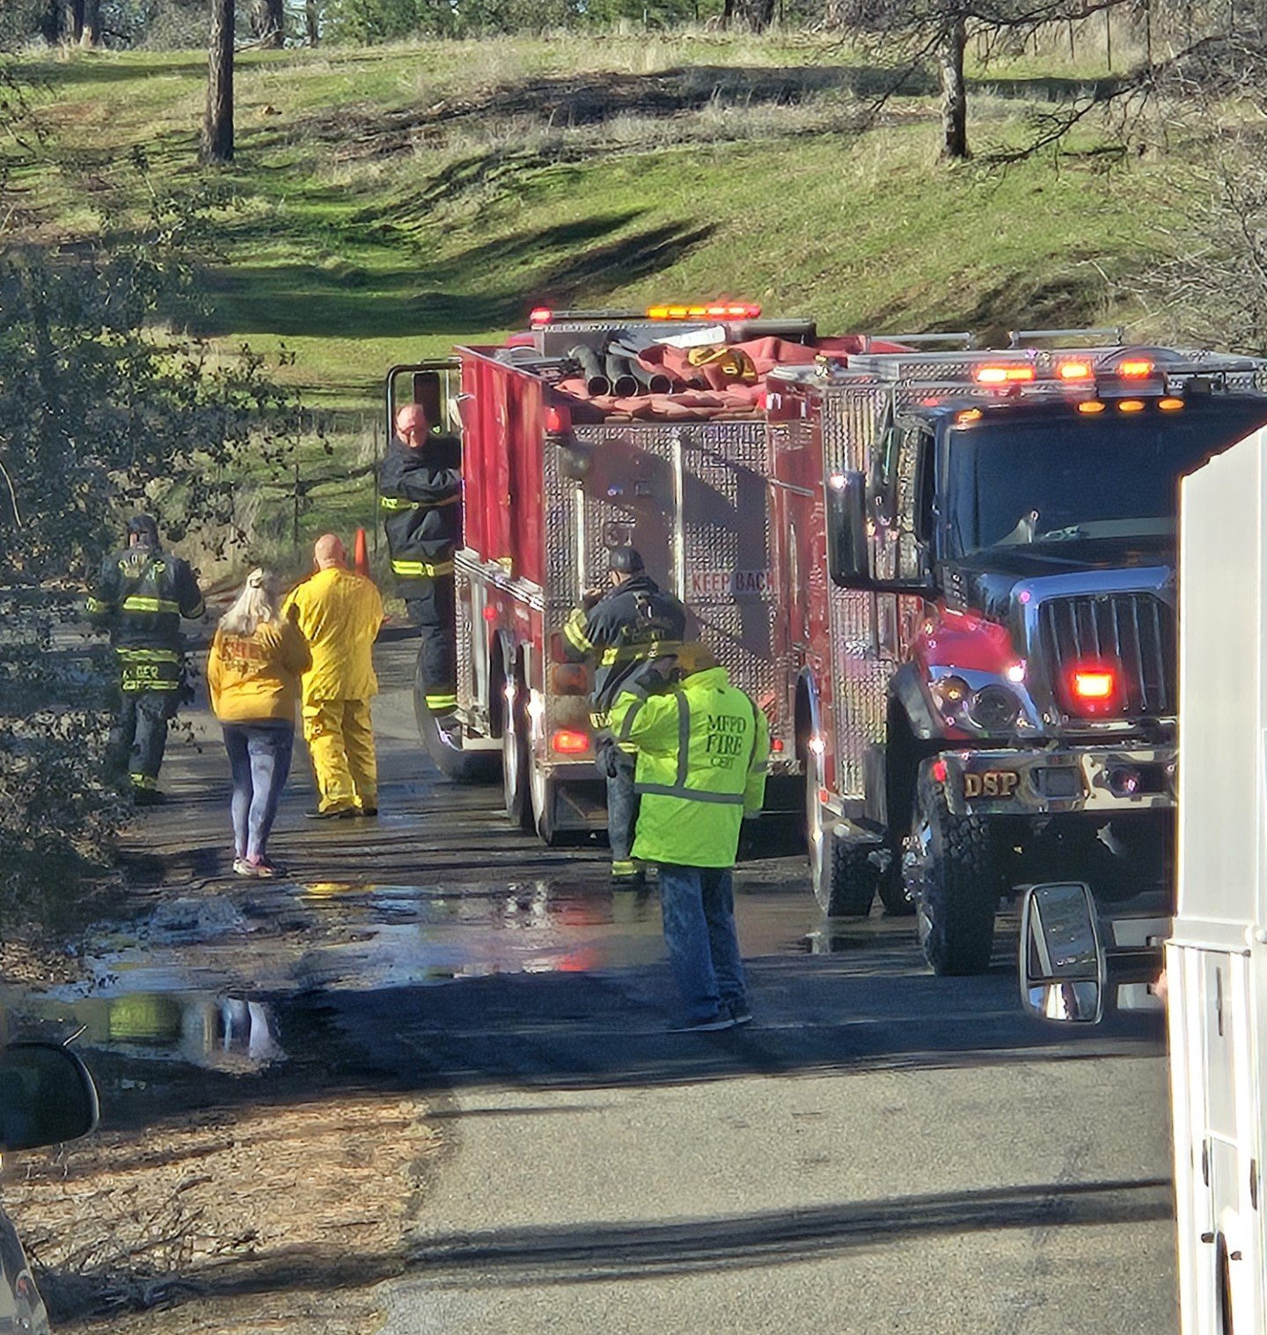
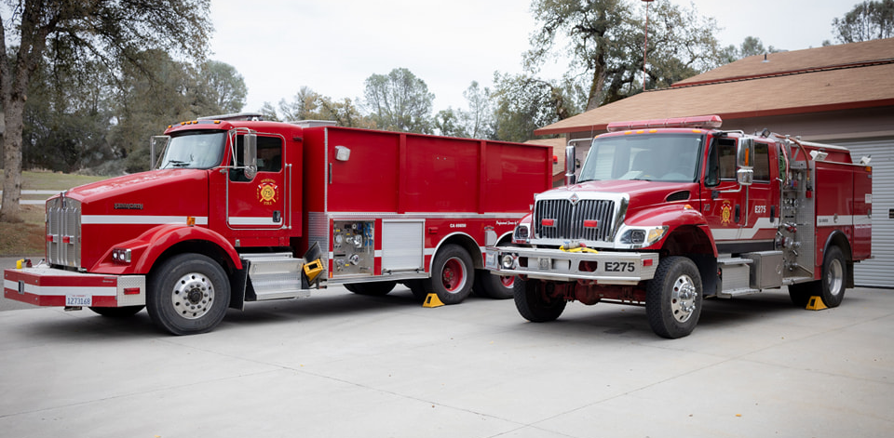

Slide 25
Financial Summary
MFPD Audited Financial Statements
 | FY 2020-21 | FY 2021-22 | FY 2022-23 | FY 2023-24
Revenues | $1,512,836 | $901,848 | $938,562 | $791,857
Expenses | $1,374,180 | $951,495 | $825,709 | $794,888
Gain/ (Loss) | $138,656 | ($49,647) | $112,853 | ($3,031)
Based on the last three years reviewed, the MFPD has seen an overall net gain of $198,831
The District does not have any long-term debt or liabilities reported in its financial statements

Slide 26
Pioneer FPD

Slide 27
Agency Overview
Formation: December 1980
Boundary Area: 181,433 acres
Population: ~8,834 (3,544 registered voters)
Staffing: 8 staff, ~ 5 active volunteers
Services:
Fire Protection
Emergency Medical Response
Hazardous Materials Response
Rescue & Extrication Operations
Fire Prevention & Safety Education

Slide 29
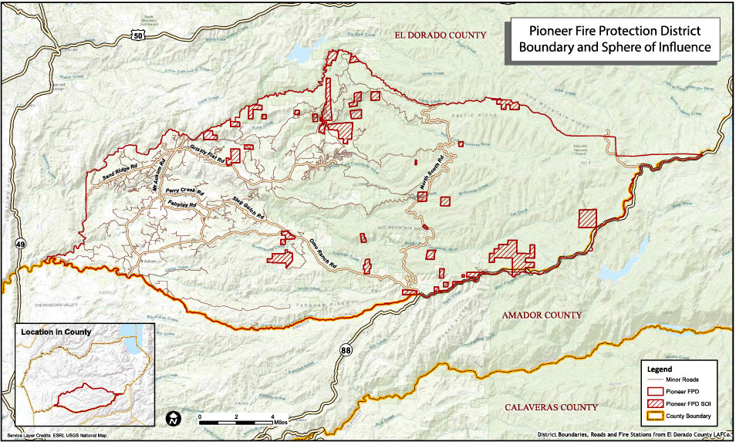

Slide 30
Fire Services
Operates from one main station in Three Forks (#38)
Additional stations include Sand Ridge (#32), Grizzly Flats (#35), and Omo Ranch (#37)
Responds to approximately 670 calls annually
~ 6% fire
~ 48% rescue & emergency medical
~ 19% service calls
Average response time of ~ 11 min (Station #38)
Current ISO rating of 4/4X (up from prior 5/5X)

Slide 31
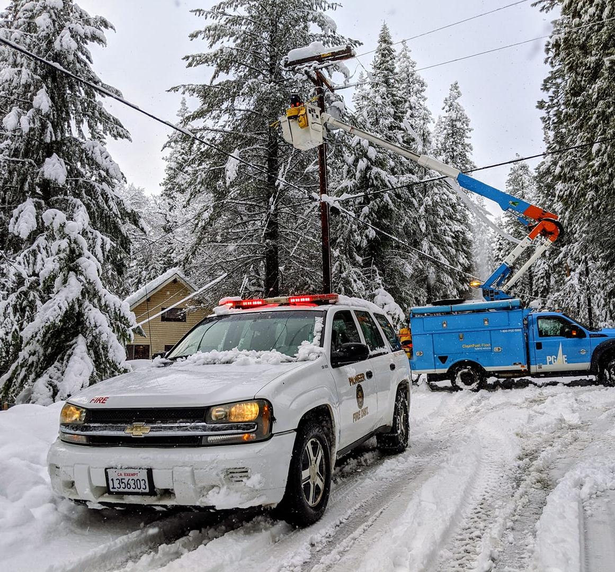
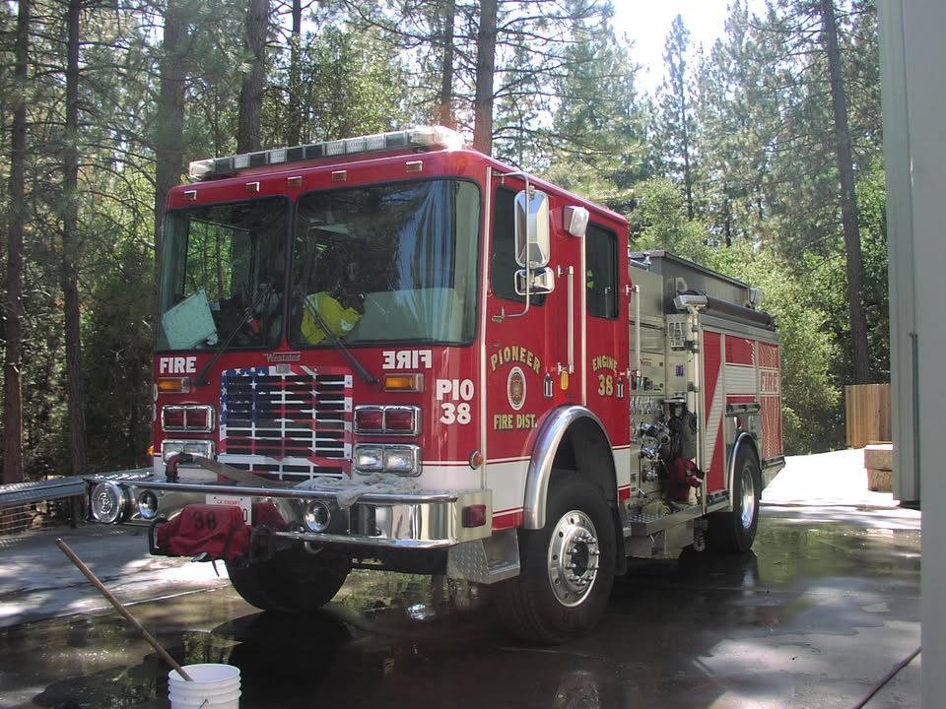
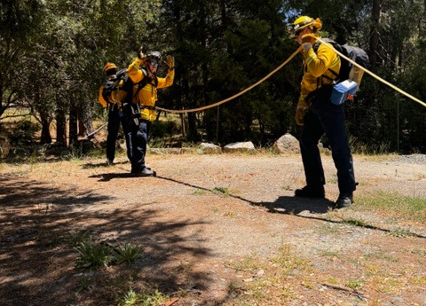

Slide 32
Financial Summary
PFPD Audited Financial Statements
 | FY 2022-23 | FY 2023-24
Revenues | $1,354,271 | $1,939,774
Expenses | $1,389,199 | $1,426,544
Gain/ (Loss) | ($34,928) | $513,230
Based on the last three years reviewed, the PFPD has seen an overall net gain of $548,158
The District does not have any long-term debt or liabilities reported in its financial statements

Slide 33
Rescue FPD

Slide 34
Agency Overview
Formation: December 1974
Boundary Area: 21,385 acres
Population: ~4,763 (3,472 registered voters)
Staffing: 8 staff, 15 reserve (including 10 trainees)
Services:
Fire Protection (Structural & Wildland)
Emergency Medical Response
Hazardous Materials Response
Rescue & Extrication Operations
Fire Prevention & Safety Education

Slide 36
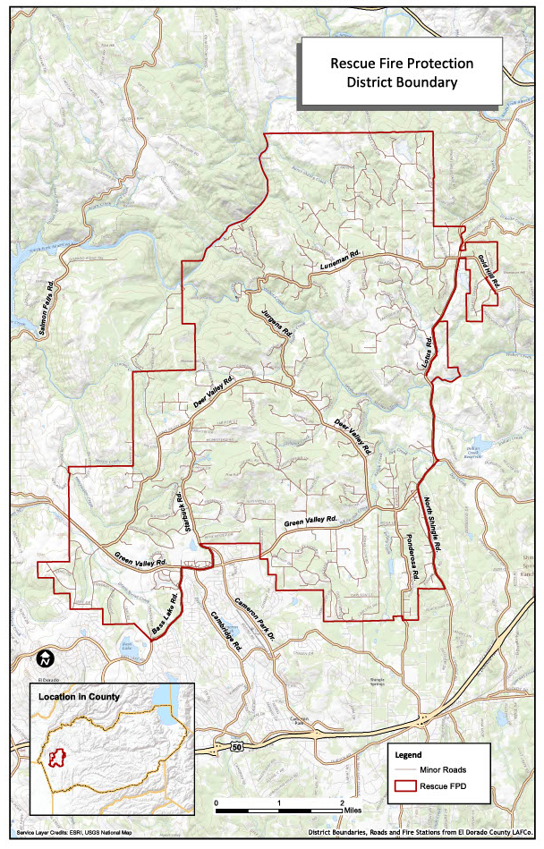

Slide 37
Fire Services
Operates from one main station in Rescue at Deer Valley Road and Green Valley Road (#83)
Additional station located on Lotus Road (#81)
Responds to approximately 1,000 calls annually
~ 8% fire
~ 67% rescue & emergency medical
~ 17% service calls
Average response time of ~ 8.5 min
Current ISO rating of 3/3X

Slide 38
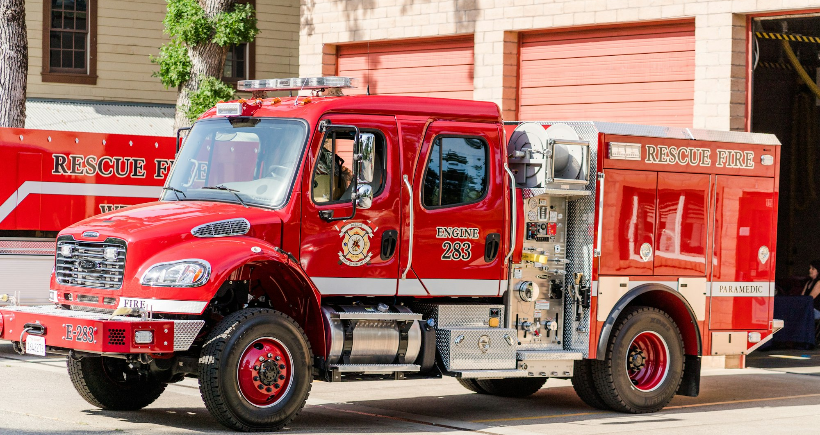
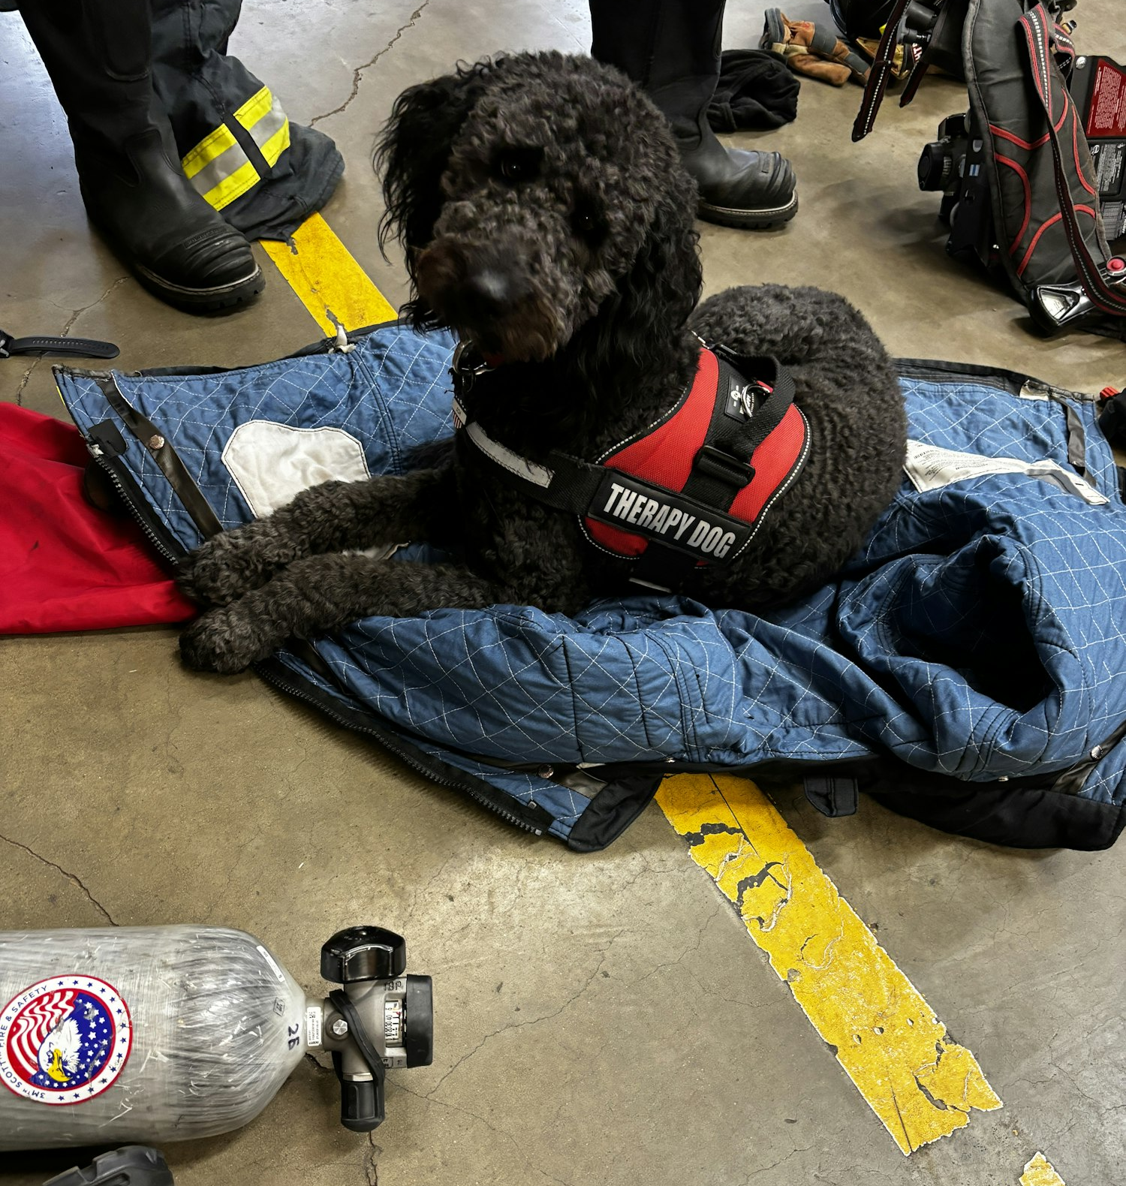
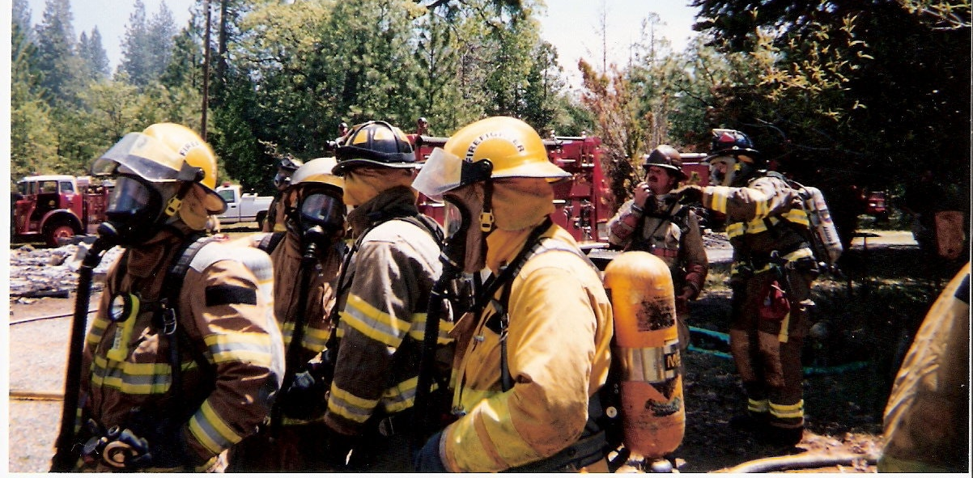

Slide 39
Financial Summary
RFPD Audited Financial Statements
 | FY 2018-19 | FY 2019-20 | FY 2020-21 | FY 2021-22
Revenues | $1,646,154 | $1,638,757 | $1,869,193 | $2,616,034
Expenses | $1,621,073 | $1,264,214 | $1,588,354 | $2,466,816
Gain/ (Loss) | $25,081 | $374,543 | $280,839 | $149,218
Based on the last three years reviewed, the MFPD has seen an overall net gain of $829,681
The District does not have any long-term debt reported in its financial statements. As of June 30, 2022, the District had $4.1 million in long-term benefits liabilities.

Slide 40

Thank You!
Krystle Brogna, AICP
Senior Planner
Planwest Partners, Inc.
(707) 825-8260
krystleb@planwestpartners.com

