Slide 1
LAFCO Incorporation Process
El Dorado Hills Community Services District Board Meeting
April 3, 2025
Shiva Frentzen, Executive Officer

Slide 2
City Incorporation Process
Pre-LAFCO Application:
Pre-LAFCO Application:
Preliminary Fiscal Analysis, Roles, Initiation (Registered Voters, Landowners, Affected Agency)
LAFCO Application:
LAFCO Application: Board Resolution to Initiate Incorporation, Proposed Incorporation Maps and Boundary Description, Feasibility Study, Service Plan, Environmental information, Application Forms, Deposit
Full Application Requirements:
Comprehensive Fiscal Analysis
Prepared by LAFCO consultant
Public hearing(s) req’d
Potential State Controller review
Revenue Neutrality
County Auditor determines property tax ratio
Proponents meet with County to negotiate
Revenue Neutrality Agreement finalized
CEQA Review
Prepared by LAFCO consultant
Initial Study – EIR likely
Public hearings & comment period for draft & final
Service Plan
Prepared by proponent or consultant
Targeted MSR-SOI(s)
Any other information deemed necessary by the Executive Officer
Notice & LAFCO Hearing:
Certificate of Filing
- Sets hearing date within 90 days
Notice of Public Hearing:
1,000+ population published in local newspaper(s)
Posted online and physical locations
LAFCO Hearing
Commission can approve with or without amendment, wholly,
partially, or conditionally, or disapprove
LAFCO Approval
LAFCO Disapproval
30-day Reconsideration Period
Proceedings Terminated
Election:
Final Conditions of Approval
Election
- Incorporation placed on next general election ballot
- LAFCO prepares impartial analysis for ballot
- Registered voters within proposed incorporation boundaries vote
- Election results certified
Majority Voter Approval
- Order Incorporation
Less than Majority Voter Approval
- Terminate Incorporation
- 2 years to reapply unless waived by LAFCO
Post-Incorporation:
Transition Year
County to continue providing services for 1 year
City reimbursement (present or future)
City SOI to be determined within 1 year, if not done during incorporation process
Certificate of Completion
After all conditions complete
State Board of Equalization Filing

Slide 3
Pre-LAFCO Application
Pre-LAFCO Application:
Preliminary Fiscal Analysis, Roles, Initiation (Registered Voters, Landowners, Affected Agency)
Consult with LAFCO early
LAFCO and Incorporation Proponents should begin working with the County and other agencies a full year ahead of application submittal
LAFCO’s Role
Proponent’s Role
Alternatives to Incorporation
Incorporation should not occur primarily for financial reasons
Preliminary Fiscal Analysis
Identify a Designated Agent and up to 3 persons to receive communication
Initiation
  Registered Voter Petition (25%)
  Landowner Petition (25%)
  Affected Agency Resolution

Slide 4
Pre-LAFCO Application
Pre-LAFCO Application:
Preliminary Fiscal Analysis, Roles, Initiation (Registered Voters, Landowners, Affected Agency)
Minimum Petition Requirements:
Registered Voters: A petition signed by at least 25% of the registered voters residing in the proposed incorporation area is submitted to LAFCO. The Registrar of Voters must verify the number of valid signatures on petitions of registered voters.
Land Owners: A petition signed by at least 25% of the landowners owning at least 25% of the assessed value of land within the proposed incorporation area. The County Assessor’s Office must verify the petitions of landowners. Landowner petitions are examined based on a comparison of signatures and the most recent assessment roll.

Slide 5
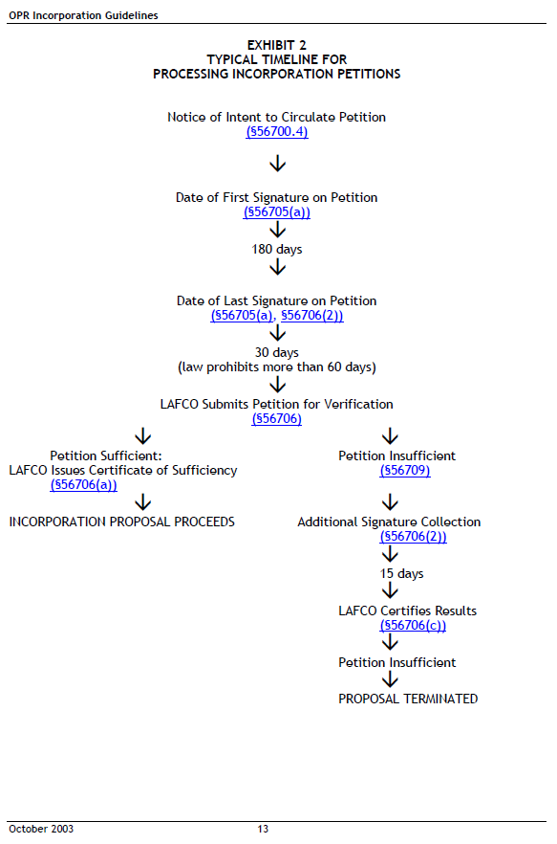
Pre-LAFCO Application
Pre-LAFCO Application:
Preliminary Fiscal Analysis, Roles, Initiation (Registered Voters, Landowners,
Affected Agency)
Timing of Petitions
A Notice of Intent must be filed with LAFCO before circulating a petition
All signatures must be gathered within 180 days (six months) from the date of the first signature
Petitions must be submitted to LAFCO within 60 days of the date of the last signature
The Executive Officer shall cause the petition to be examined by the Registrar of Voters or County Assessor’s Office
The Executive Officer shall issue a Certificate of Sufficiency or Notice of Insufficiency within 30 days after the date a petition is received
If the petition is insufficient, proponents have 15 days to submit a supplemental petition
The Executive Officer shall examine the supplemental petition and certify in writing the results within 10 days after the
date of filing

Slide 6
LAFCO Application
LAFCO Application: Board Resolution to Initiate Incorporation, Proposed Incorporation Maps and Boundary Description, Feasibility Study, Service Plan, Environmental information, Application Forms, Deposit
Petition or Resolution to Initiate Incorporation
Description of Incorporation proposal
  Reasons for incorporation, statement of concerns, changes to public services, brief history, demographic/geographic/economic data
Proposed Incorporation maps and boundary description
  Identify proposed incorporation boundaries and alternative boundaries
  Proposed Incorporation map and description to be approved by County Surveyor
Feasibility Study
  Estimates potential municipal costs and revenues for city services
Service Plan
  Plan for providing services prepared in compliance with California Government Code §56653
Environmental Information
  LAFCO is lead agency for California Environmental Quality Act (CEQA). A completed Environmental Information Form is required to facilitate LAFCO’s environmental review
Application forms
  Disclosure of Gifts, Project Information Form, Reimbursement Agreement, Legal Indemnity
Deposit towards estimated costs

Slide 7
Full Application Requirements
Comprehensive Fiscal Analysis
Prepared by LAFCO consultant
Public hearing(s) req’d
Potential State Controller review
Revenue Neutrality
County Auditor determines property tax ratio
Proponents meet with County to negotiate
Revenue Neutrality Agreement finalized
CEQA Review
Prepared by LAFCO consultant
Initial Study – EIR likely
Public hearings & comment period for draft & final
Service Plan
Prepared by proponent or consultant
Any other information deemed necessary by the Executive Officer
Targeted MSR-SOI(s)
Comprehensive Fiscal Analysis
  Prepared by LAFCO consultant
  Data request letters sent to all agencies/County at the start of the FY
  Public hearing(s) required
  Potential State Controller’s Office review
  The CFA should:
    Address revenue neutrality
    Address fiscal implications of proposed changes in services
    Establish the base year cost
    Calculate the property tax transfer
    Develop budget projections for the next 10 fiscal years

Slide 8
Full Application Requirements
Comprehensive Fiscal Analysis
Prepared by LAFCO consultant
Public hearing(s) req’d
Potential State Controller review
Revenue Neutrality
County Auditor determines property tax ratio
Proponents meet with County to negotiate
Revenue Neutrality Agreement finalized
CEQA Review
Prepared by LAFCO consultant
Initial Study – EIR likely
Public hearings & comment period for draft & final
Service Plan
Prepared by proponent or consultant
Targeted MSR-SOI(s)
Any other information deemed necessary by the Executive Officer
Revenue Neutrality
  County Auditor determines property tax ratio
  Proponents and LAFCO meet with County to negotiate (negotiating committee)
  Ways to achieve revenue neutrality:
    Tax sharing agreements
    Lump-sum payments
    Payments over a fixed period of time
    Modification of incorporation boundaries
    Any other terms acceptable to all parties
  Revenues and expenditures must be “substantially equal” for LAFCO to approve
  Revenue Neutrality Agreement finalized – all parties must agree

Slide 9
Full Application Requirements
Comprehensive Fiscal Analysis
Prepared by LAFCO consultant
Public hearing(s) req’d
Potential State Controller review
Revenue Neutrality
County Auditor determines property tax ratio
Proponents meet with County to negotiate
Revenue Neutrality Agreement finalized
CEQA Review
Prepared by LAFCO consultant
Initial Study – EIR likely
Public hearings & comment period for draft & final
Service Plan
Prepared by proponent or consultant
Targeted MSR-SOI(s)
Any other information deemed necessary by the Executive Officer
CEQA Review
  Incorporations are subject to the California Environmental Quality Act (CEQA) and require environmental review
  Prepared by LAFCO consultant
  Initial Study (EIR likely)
  Public hearings and comment period for draft and final

Slide 10
Full Application Requirements
Comprehensive Fiscal Analysis
Prepared by LAFCO consultant
Public hearing(s) req’d
Potential State Controller review
Revenue Neutrality
County Auditor determines property tax ratio
Proponents meet with County to negotiate
Revenue Neutrality Agreement finalized
CEQA Review
Prepared by LAFCO consultant
Initial Study – EIR likely
Public hearings & comment period for draft & final
Service Plan
Prepared by proponent or consultant
Targeted MSR-SOI(s)
Any other information deemed necessary by the Executive Officer
Service Plan
  Prepared by Proponent or Proponent’s consultant
  Shall include:
    (1) An enumeration and description of the services currently provided or to be extended to the affected territory.
    (2) The level and range of those services.
    (3) An indication of when those services can feasibly be extended to the affected territory, if new services are proposed.
    (4) An indication of any improvement or upgrading of structures, roads, sewer or water facilities, or other conditions the local agency would impose or require within the affected territory if the change of organization or reorganization is completed.
    (5) Information with respect to how those services will be financed.

Slide 11
Full Application Requirements
Comprehensive Fiscal Analysis
Prepared by LAFCO consultant
Public hearing(s) req’d
Potential State Controller review
Revenue Neutrality
County Auditor determines property tax ratio
Proponents meet with County to negotiate
Revenue Neutrality Agreement finalized
CEQA Review
Prepared by LAFCO consultant
Initial Study – EIR likely
Public hearings & comment period for draft & final
Service Plan
Prepared by proponent or consultant
Targeted MSR-SOI(s)
Any other information deemed necessary by the Executive Officer
Targeted MSR-SOI:
  El Dorado Hills CSD
Possible targeted MSR-SOIs for other districts:
  Rolling Hills CSD
  Marble Mountain Homeowners CSD

Slide 12
Notice and LAFCO Hearing
Certificate of Filing
- Sets hearing date within 90 days
Notice of Public Hearing:
1,000+ population published in local newspaper(s)
Posted online and physical locations
LAFCO Hearing
Commission can approve with or without amendment, wholly,
partially, or conditionally, or disapprove
LAFCO Approval
LAFCO Disapproval
30-day Reconsideration Period
Proceedings Terminated
Final Conditions of Approval
EO issues Certificate of Filing – hearing date within 90 days
Notice of LAFCO Hearing
  21 days in advance of hearing
  1/8 page add published in local newspaper(s) (1,000+ voters/landowners)
  Posted on LAFCO website, LAFCO office/bulletin, BOS hearing location
LAFCO Hearing
  Executive Officer staff report with recommendation and Terms and Conditions
  Commission can approve with or without amendment, wholly, partially, or conditionally, or disapprove
  30-day reconsideration period after approval

Slide 13
Election
Election
- Incorporation placed on next general election ballot
- LAFCO prepares impartial analysis for ballot
- Registered voters within proposed incorporation boundaries vote
- Election results certified
Majority Voter Approval
- Order Incorporation
Less than Majority Voter Approval
- Terminate Incorporation
- 2 years to reapply unless waived by LAFCO
Election
  LAFCO informs BOS and Elections; County calls for an election (at least 88 days later)
  Incorporation placed on next general election ballot
  If special election is requested, proponents pay for the cost
  LAFCO prepares impartial analysis for ballot
  Registered voters within proposed incorporation boundaries vote
  County Election certifies results; BOS adopts election resolution and sends to LAFCO
    Majority voter approval – order incorporation
    Less than majority approval – terminate incorporation (2 year wait for new application)

Slide 14
Post-Incorporation
Certificate of Completion
After all conditions complete
State Board of Equalization Filing
Transition Year
County to continue providing services for 1 year
City reimbursement (present or future)
City SOI to be determined within 1 year, if not done during incorporation process
LAFCO records Certificate of Completion with effective date of incorporation
Post-Incorporation
  Transition Year (municipal organization period)
    County shall continue to provide services for one year following incorporation, with reimbursement from the city (present or future)
    City may need to find “bridge” financing to match initial expenses to collections and cashflow
    LAFCO shall determine city SOI within one year of incorporation, if not done so during incorporation process

Slide 15
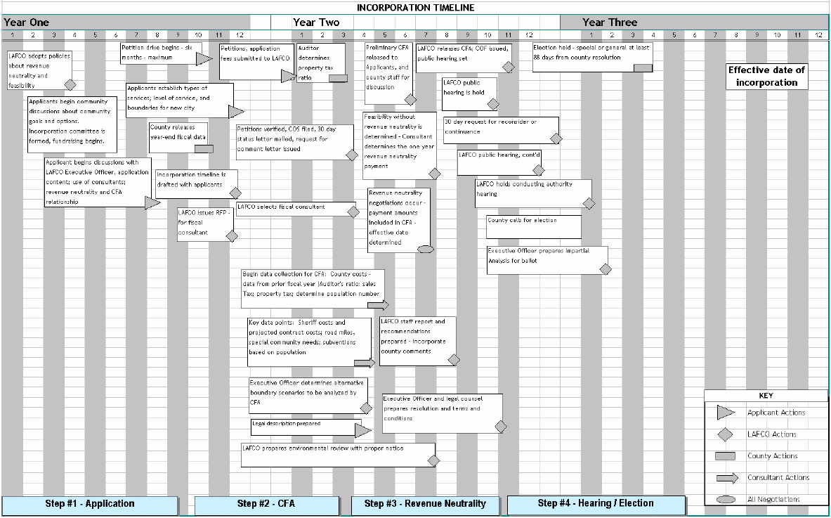

Slide 16
Resources
We have used the following incorporation resources:
- OPR Guidelines to the LAFCO Process for Incorporations
- LAFCO Incorporation Policies & Guidelines Section 6.7 Incorporations
- Cortese-Knox-Hertzberg Local Government Reorganization Act
- OPR Sample Timeline Appendix H – Incorporation Timeline

Slide 17
Questions?

